Slide 1
Day 03
Sampling: NUTS, ADVI
Choosing a prior
AB testing, hierarchical models, Phase shift in time series

Slide 2
Today
Choosing the prior that's right for you
Phase shifting
A/B testing
Hierarchical models

Slide 3
Priors

Slide 4
Choosing a prior
https://github.com/stan-dev/stan/wiki/Prior-Choice-Recommendations
* Flat prior;
* Super-vague but proper prior: normal(0, 1e6);
* Weakly informative prior, very weak: normal(0, 10);
* Generic weakly informative prior: normal(0, 1);
* Specific informative prior: normal(0.4, 0.2) or whatever. Sometimes this can be expressed as a scaling followed by a generic prior: theta = 0.4 + 0.2*z; z ~ normal(0, 1);
see Also Kruschke paper
"Even though the prior distribution is often selected to be noncommittal, this does not imply that the prior distribution is an inconvenient nuisance for which a researcher must apologize."
"a well-informed prior distribution can provide inferential leverage."
see also : Bayesian Methods for Hackers Ch6_Priors_PyMC3.ipynb

Slide 5
Phase detection

Slide 6
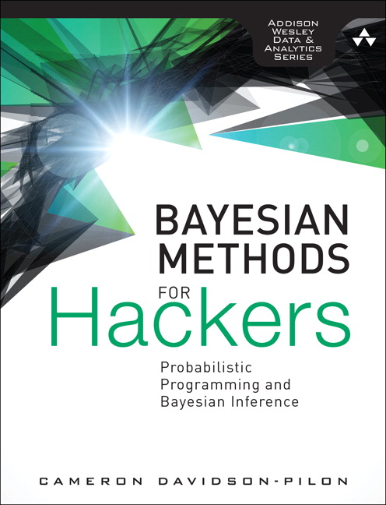
Bayesian Methods for Hackers
https://github.com/CamDavidsonPilon/Probabilistic-Programming-and-Bayesian-Methods-for-Hackers
Did the user change his / her habits over time?

Slide 7
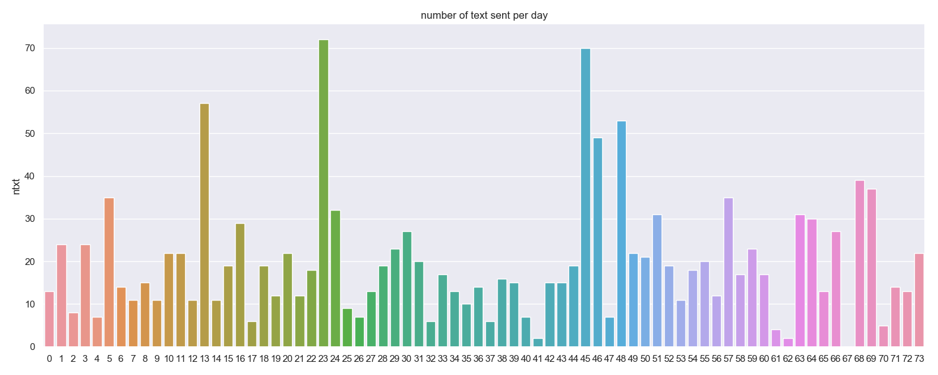
Did the user change his / her texting habits over time ?

Slide 8
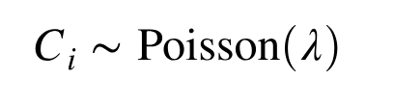
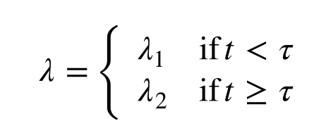
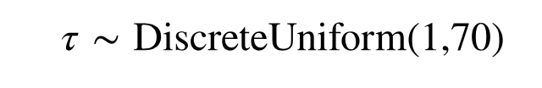
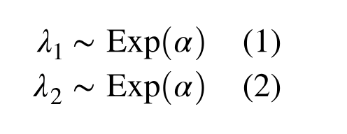
Modelisation
Number of texts sent ~ Poisson(lambda) over a period
If there is a time shift, then at some time tau, lambda changes
tau: The switch between lambda_1 and lambda_2 may happen at anytime
And we assume lambdas both follow the same exponential distribution with parameter alpha

Slide 9
AB testing

Slide 10
A/B Testing
# A/B testing
AB testing example in Ch2_MorePyMC_PyMC3
http://localhost:8888/notebooks/day_02/Ch2_MorePyMC_PyMC3.ipynb#Example:-Bayesian-A/B-testing
see also
Bayesian Poisson A/B Testing in PYMC3 on Python
http://barnesanalytics.com/bayesian-poisson-ab-testing-in-pymc3-on-python
A/B Testing with Hierarchical Models in Python
https://blog.dominodatalab.com/ab-testing-with-hierarchical-models-in-python/

Slide 11
A/B testing
2 versions of a web site: A and B, which version produces more sales?
Estimating P_A and P_B probability conversions for each versions
observed frequency != true frequency

Slide 12
Hierarchical Models

Slide 13
Hierarchical models
More levels between the likelihood and the prior
level 1: Data come from a distribution with parameters θ
X∼f(X | θ)
Level 2: parameters come from another distribution with parameters λ
θ∼g(θ | λ)
Level 3: λ comes from a prior distribution
λ∼h(λ)
Main idea: Since the θs are not independent but rather are drawn from a common distribution with parameter λ, we can share information across the θs by also estimating λ at the same time.
http://people.duke.edu/~ccc14/sta-663-bootstrap/MCMC.html#hierarchical-models

Slide 14
multiple-comparison-type errors
if you have one observation of \(2.326\), you would reject the hypothesis that it came from a \(N(0,1)\) distribution (with \(p = 0.01\)). But if you have a hundredobservations and one of them \(x\) is above \(2.326\), you may not be able to reject the hypothesis that \(x\) came from a \(N(0,1)\) distribution; after all, we would expect to see one such \(x\) if all hundred samples were drawn from \(N(0,1)\).
It's rare to have an A/B test with \(100\) different variants, but the same pattern occurs with fewer variants too -- it's just less pronounced. Failing to account to this will inflate your false positive rate whenever you run a test with multiple variants.
https://sl8r000.github.io/ab_testing_statistics/use_a_hierarchical_model/
=> Hierarchical models

Slide 15
hierarchical models
model all of the test buckets at once, rather than treating each in isolation.
the number of sign-ups, k_{i}, is modeled by Binomial(n_{i},p_{i}), and the true sign-up rate for each website, p_{i}, is drawn from Beta(a,b). Now, we’ve neglected one important question up until this point? How do we choose a and b?
sample a and b from the distribution f(a,b) ~ (a+b)^{-5/2} where a,b > 0.

Slide 16
Other samplings
HMC, NUTS, AVI

Slide 17
Gradient-based sampling methods
PyMC3 implements several standard sampling algorithms, such as adaptive Metropolis- Hastings and adaptive slice sampling, but PyMC3’s most capable step method is the No-U-Turn Sampler. NUTS is especially useful for sampling from models that have many continuous parameters, a situation where older MCMC algorithms work very slowly. It takes advantage of information about where regions of higher probability are, based on the gradient of the log posterior-density. This helps it achieve dramatically faster convergence on large problems than traditional sampling methods achieve. PyMC3 relies on Theano to analytically compute model gradients via automatic differentiation of the posterior density. NUTS also has several self-tuning strategies for adaptively setting the tunable parameters of Hamiltonian Monte Carlo. For random variables that are undifferentiable (namely, discrete variables) NUTS cannot be used, but it may still be used on the differentiable variables in a model that contains undifferentiable variables.

Slide 18
Chris fonnebeck video
https://youtu.be/5TyvJ6jXHYE?t=1188
1. MCMC and Metropolis - Random Walk based sampling
2. Hamiltonian MC
3. NUTS

Slide 19
A Conceptual Introduction to Hamiltonian Monte Carlo Michael Betancourt 1701.02434.pdf
Gibbs sampling and HMC in: An Introduction to Probabilistic Programming 1809.10756.pdf CH 3
see https://en.wikipedia.org/wiki/Metropolis%E2%80%93Hastings_algorithm
Gibbs sampling, involves choosing a new sample for each dimension separately from the others, rather than choosing a sample for all dimensions at once.
see also http://people.duke.edu/~ccc14/sta-663-bootstrap/MCMC.html
Advantages of Gibbs sampling
No need to tune proposal distribution
Proposals are always accepted
Disadvantages of Gibbs sampling
Need to be able to derive conditional probability distributions
need to be able to draw random samples from contitional probability distributions
Can be very slow if paramters are correlated becauce you cannot take “diagonal” steps (draw picture to illustrate)

Slide 20
ADVI - ELBO
Varying intercept model = ADVI https://youtu.be/5TyvJ6jXHYE?t=1295
Kullback Leibler divergence
sampling becomes optimization
can't get to posterior distribution directly
minimizing ELBO <=> max KL distance
ADVI: Automatic Differentiation Variational Inference

Slide 21
ADVI

Slide 22
Kullback Leibler divergence
Evidence Lower Bound (ELBO)
https://youtu.be/5TyvJ6jXHYE?t=1196

Slide 23
HMC Hamiltonian Monte Carlo explained
https://arogozhnikov.github.io/2016/12/19/markov_chain_monte_carlo.html
visual demo et some math

Slide 24
Correlation
Influence of correlation on MCMC

Slide 25
specific loss functions

Slide 26
Hierarchical Linear Regression

Slide 27
Car models
https://blog.applied.ai/bayesian-inference-with-pymc3-part-3/
https://s3-eu-west-1.amazonaws.com/appliedai-bd4230b45d5a278bf906ab9c19dfa338cdc93cd4/pymc3linearmodels/93_HierarchicalLinearRegression.html

Slide 28
A Primer on Bayesian Methods for Multilevel Modeling
https://nbviewer.jupyter.org/github/fonnesbeck/multilevel_modeling/blob/master/multilevel_modeling.ipynb?create=1
Radon contamination (Gelman and Hill 2006)

Slide 29
Phase detection

Slide 30
Phase detection in time series
- IoT, simple texting example
- application to ELX sales, financial series, ...
Etant donnée une serie temporelle, nous allons detecter si un changement de phase apparait et determiner les parametres des differentes phases.
- Etude d'un cas d'école: nombre de messages émis par jour sur une periode donnée.
- Modelisation du phénomène, resultats, interpretation

